Slide 1
Landing page tutorial AC Access websites

Slide 2
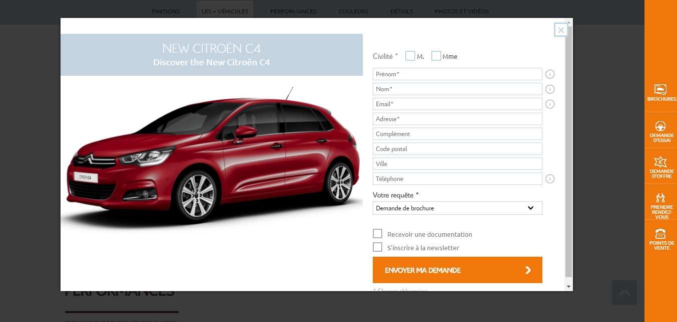
The landing page on Access : 2 possibilities
The LP as a pop-in in a showroom
The pop-in appears as the user scrolls down in the showroom

Slide 3
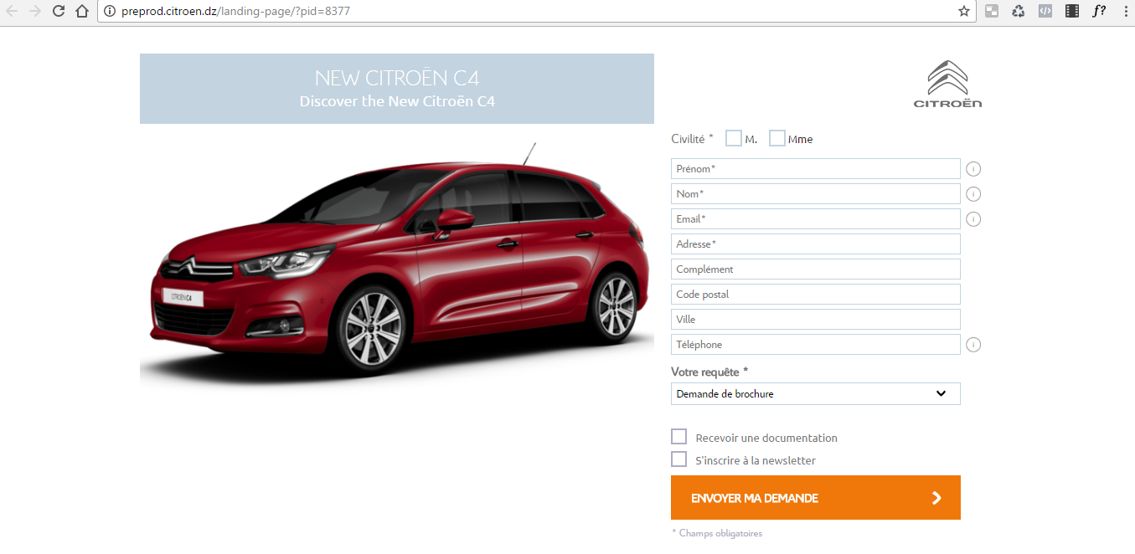
The landing page on Access : 2 possibilities
The LP as a standalone page
The URL of the landing page can be used as the target destination of digital campaigns

Slide 4
1. First step : create the Landing Page template in your back office
Go to the Pages section of the back office, and click on « Add new » to create a new page.

Slide 5
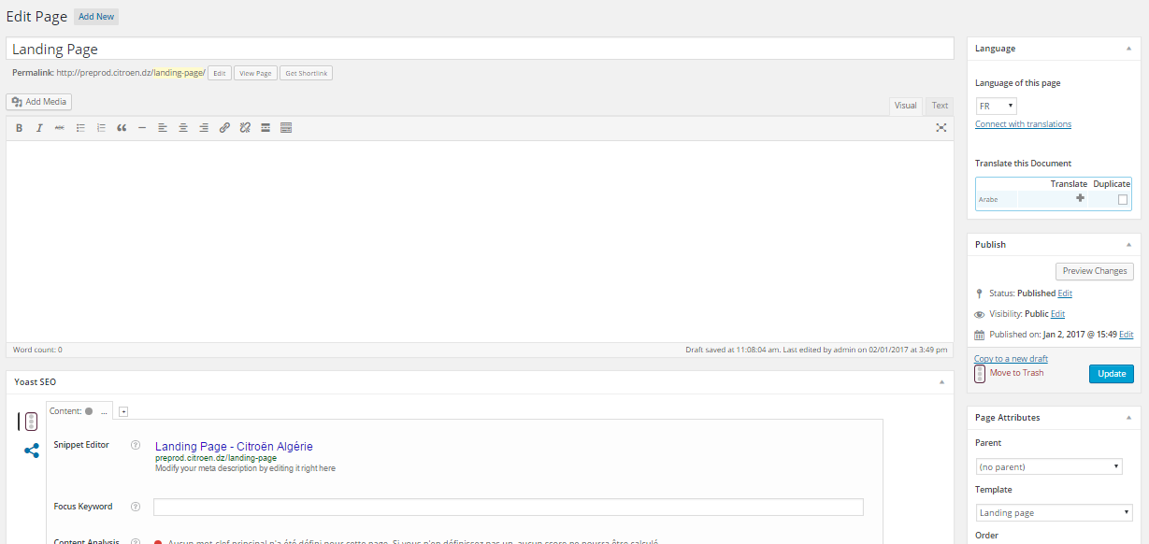
1. First step : create the Landing Page template in your back office
In the title section, just write « Landing Page ». All the other fields can remain empty.
In the template section, choose the template « Landing Page »
You can then click on « Publish », and the landing page template will be activated on your website. This page will not appear in the front office – it is only to activate the landing pages.

Slide 6
1. First step : create the Landing Page template in your back office
BILINGUAL WEBSITES
For bilingual websites, please be sure to create the landing page template in both languages : first in the back office in the main language of the website, and then in the back office in the secondary language of the website

Slide 7
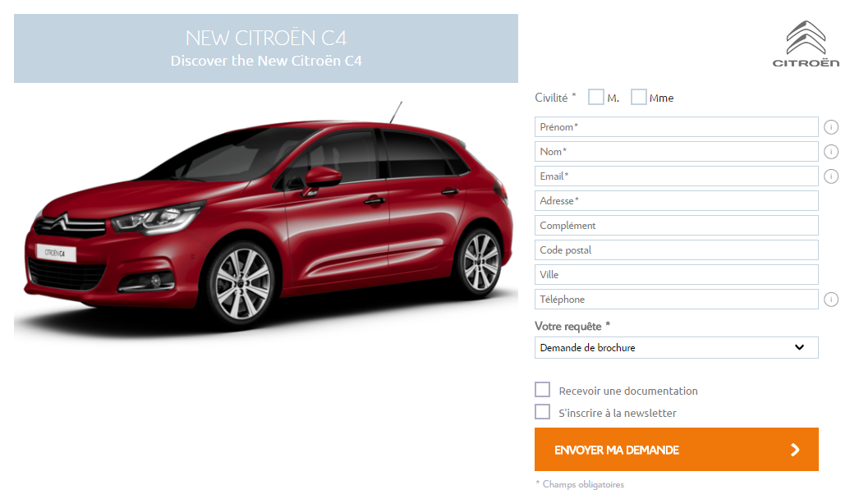
2) How to create a landing page
Landing page example
Title and subtitle: see slide 9
Image: see slide 9
Fields: see slides 11-12

Slide 8
2. How to create a landing page
The landing pages are created, activated and deleted in this section of the back office.
To create a landing page, go to this tab and click on « Add new ».

Slide 9
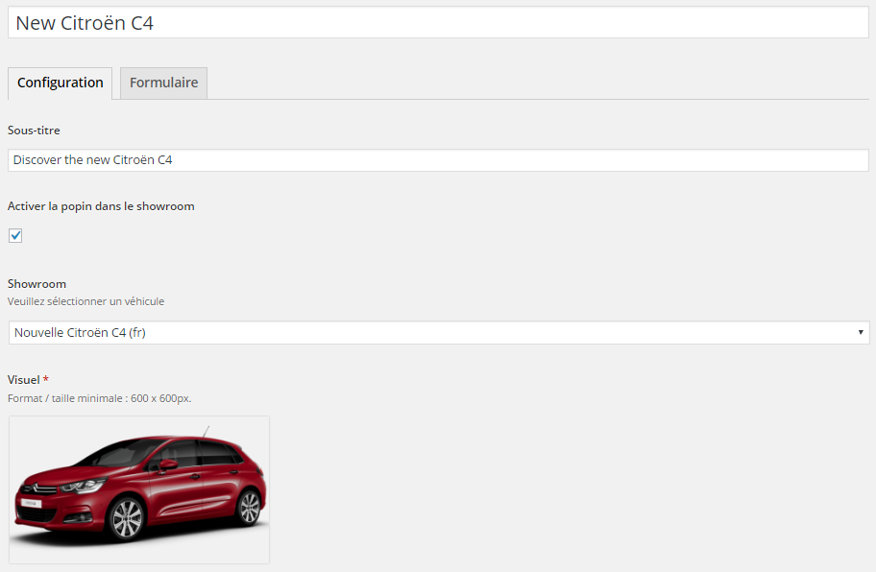
2. How to create a landing page
Step 1: Configuration of the LP
Title of the landing page – Mandatory – Appears in front office
Subtitle of the landing page – Optional– Appears in front office
Showroom box – Optional – Check this box if you want to link the landing page to a showroom – The landing page will appear a a pop in in the selected showroom
Showroom selection – Select the showroom that you want to link to the landing page
If you did not check the Showroom box, this field will not appear
Visual – Upload here the visual of the landing page – Recommended size : 1100x1100
It can be a visual promoting a vehicle / a service (in this case, do not link the landing page to a showroom) / a range, etc.

Slide 10
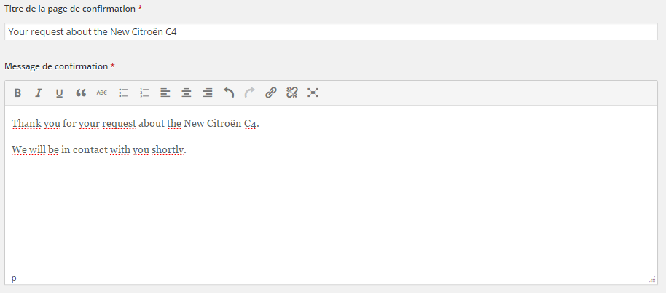
2. How to create a landing page
Step 2: Configuration of the confirmation page
Title of the confirmation page – Mandatory field – This title appears in the front office
Text of the confirmation page – Mandatory field – This text appears in the front office

Slide 11
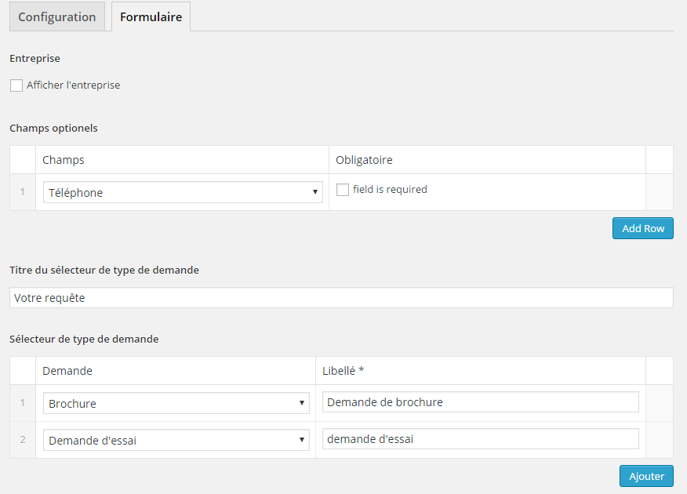
2. How to create a landing page
Step 3: Configuration of the fields of the landing page
Business – Optional – Check this box if you want the customer to have to choose between “Private individual” and “Business customer”
Fields – Choose here the different fields you want on the form – Name, surname and email address are present by default – You can add Phone, Address, Zip code and City
“Your Request” – Enter here the title of the “Your Request” field – By default,if you don’t write anything here, it will be “Your Request”
Types of request – Select here the different types of request you want on the form : Offer, Test Drive, Meeting, Contact, Brochure

Slide 12
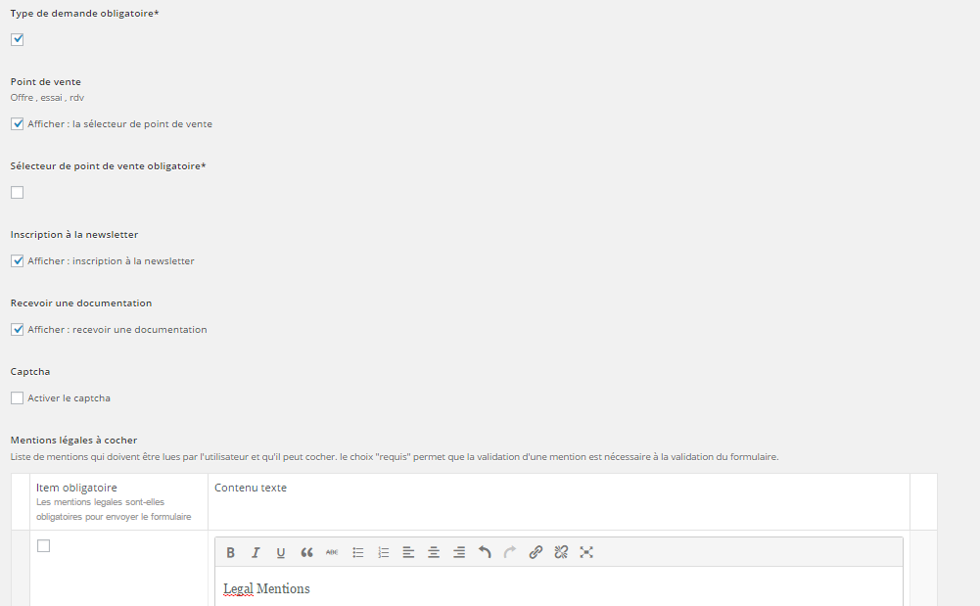
2. How to create a landing page
Step 3: Configuration of the fields of the landing page
Check this box – The customer has to choose a type of request to validate the form
Point of sale box – Check this box if you have activated one of the following types of request : Offer / Test drive / Meeting and if you wznt the customer to choose a point of sale
Make Point of sale mandatory – Check this box if you want to make the selection of a point of sale mandatory for the validation of the form
Newsletter box – Check this box if you want to have the newsletter subscription to appear on the form
Documentation box – Check this box if you want to have the documentation request to appear on the form
Captcha box – Check this box if you want to activate the captcha on the form
Legal Mentions – Click on “Add row” to add legal mentions

Slide 13
2. How to create a landing page
Special step: Configuration of the confirmation page button (landing page used as destination page for digital campaigns)
When the landing page is linked to a showroom : on the confirmation page, after validation of the form, there is a button « See the showroom » that brings the customer back to the showroom of the car.
When the landing page is not linked to a showroom : you have to indicate in the back office the text of the button + the url to which the button will redirect. For example, if the landing page is used to promote special prices on a service, you can create a special page in the Offers section and then redirects to this url after validation of the form. It can be the homepage if there is no special Offer page dedicated to the promotion.
See next slide for back office view

Slide 14
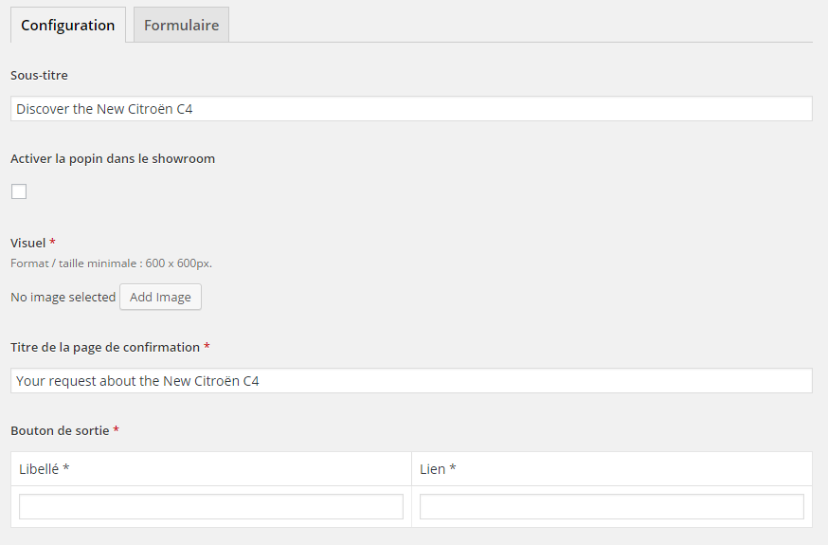
2. How to create a landing page
Special step: Configuration of the confirmation page button (landing page used as destination page for digital campaign and not linked to a showroom)
Add here the title of the button
Add here the url where the button will redirect

Slide 15
2. How to create a landing page
Step 3: Configuration of the fields of the landing page
The landing page is now completed – you can publish the page.

Slide 16
2. How to create a landing page
Step 4: Configuration of the confirmation email
As for all other forms, the customer receives a confirmation email after having validated a landing page.
To configure this confirmation email, go to Options / Form settings, and then go to the Landing Page tab.
Indicate :
The email address where the notifications email will be sent after validation of a landing page form
The title of the confirmation email that the customer receives
The text of the confirmation email that the customer receives

Slide 17
3. 2 possible uses of the landing page
The landing page as a pop-in in a showroom
Showroom box – Optional – Check this box if you want to link the landing page to a showroom – The landing page will appear a a pop in in the selected showroom
The pop-in will appear as the user scrolls down in the « Strong Points » part of the showroom.
Please make sure that the « Strong Points » part is activated in the vehicle’s showroom.
Otherwise the pop-in will not appear.

Slide 18
3. 2 possible uses of the landing page
The landing page as a target destination for digital campaigns
Follow the process for the creation of a landing page. Don’t check the box « Activate pop-in in the showroom » if you don’t want the pop-in. Publish your landing page.
Go to the list of landing pages created in your back office and copy the url of the landing page you want to use as target destination:

Slide 19
IMPORTANT POINTS
There can be only one landing page connected to each vehicle
For the bilingual websites: you must create each landing page twice, in both languages
If you use the landing page as a pop-in in a showroom, make sure that the “Strong Points” section is activated for this vehicle
Minimum size of the visual: 1100x1100 – You can use bigger images, but please be sure to respect the square format

Slide 20
Thank you !

